Slide 1
Contemporary Moral Problems
SUM2014, M-F12:00-1:00, SAV 264
Instructor: Benjamin Hole
Office Hours: M-F1-1:15
Email: bvhole@uw.edu

Slide 2
Agenda
Administrative questions?
Clicker Quiz
“Moral Theory Primer”

Slide 3
Overview
“Six Essential”
Theories
Ethics by Authority
Consequentialism
Kantian Ethics
Natural Law Theory
Rights Based Moral Theory
Virtue Ethics
Prima Facie Duties
Divine Command Theory
Ethical Relativism

Slide 4

QUIZ
Please set your Turning Technology Clicker to channel 41
Press “Ch”, then “41”, then “Ch”

Slide 5
1. Which of the following is a kind of consequentialist theory that explains right action in terms of the net balance of pleasure (or lack of pain) produced by that action?
hedonistic utilitarianism
perfectionist consequentialism
by definition, consequentialist theories do not mention pain

Slide 6
2. Which of the following is a basic intrinsic good of natural law theory?
Human life
Human procreation
Human sociability
All of the above
None of the above

Slide 7
2. Consequential approaches to ethical theory:
Take the good as primary and the right as derivative
Take the right as primary and the good as derivative
Are value-based
Are duty-based
A & C
B & D

Slide 8
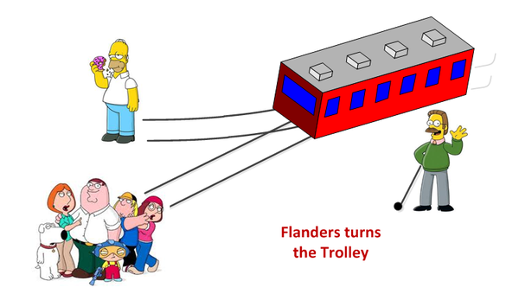
Trolley Problem

Slide 9
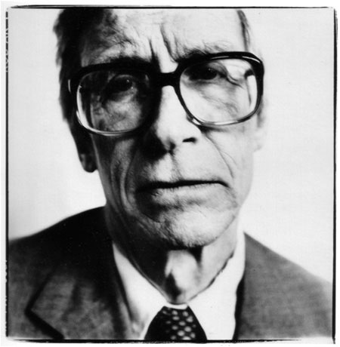
The Right (Duty) & The Good (Value)
“The two main concepts of ethics are those of the right and the good”
(Rawls, A Theory of Justice, 24).
“value based moral theories” vs. “duty based moral theories”

Slide 10
Principles
“moral principles – very general moral statements that specify the conditions under which an action is right (or wrong) and something is intrinsically good (or bad)” (4).
Note: “if and only if (and because)”

Slide 11
Overview
“Six Essential”
Theories
Ethics by Authority
Consequentialism
Kantian Ethics
Natural Law Theory
Rights Based Moral Theory
Virtue Ethics
Prima Facie Duties
Divine Command Theory
Ethical Relativism

Slide 12
Preferred ethical theory
Consequentialism
Kantian Ethics
Natural Law Theory
Rights Based Moral Theory
Virtue Ethics
Prima Facie Duties
Divine Command Theory
Cultural Relativism

Slide 13
Consequentialism
“Right action is to be understood entirely in terms of the overall intrinsic value of the consequences of the action compared to the overall intrinsic value of the of the consequences associated with alternative actions an agent might perform instead. An action is right if and only if (and because) its consequences would be at least as good as the consequences of any alternative action that the agent might instead perform.”
What is intrinsically valuable?
Hedonism
Desire Satisfaction Theory
Perfectionism / Objective List Theory

Slide 14
Rule Consequentialism
“An action is right if and only if (and because) it is permitted by a rule whose associated acceptance value is at least as high as the acceptance value of any other rule applying to the situation.”
What is intrinsically valuable?
Hedonism
Desire Satisfaction Theory
Perfectionism / Objective List Theory

Slide 15
Consequentialism
Strongly Agree
Agree
Somewhat Agree
Neutral
Somewhat Disagree
Disagree
Strongly Disagree

Slide 16
Kant’s Categorical Imperative: Universal Law Formulation
“An action is right if and only if one can both (a) consistently conceive of everyone adopting and action on the general policy (that is, a maxim) of one’s action, and also (b) consistently will that everyone act on that maxim.”

Slide 17
Kant’s Categorical Imperative: Humanity Formulation
“An action is right if and only if (and because) the action treats persons (including oneself) as an ends in themselves and not as mere means.”

Slide 18
Kant’s Categorical Imperative
Strongly Agree
Agree
Somewhat Agree
Neutral
Somewhat Disagree
Disagree
Strongly Disagree

Slide 19
Natural Law Theory
“An action is right if and only if (and because) in performing the action one does not directly violate any of the basic values”
Human Life
Human Procreation (which includes raising children)
Human Knowledge
Human Sociability

Slide 20
Natural Law Theory
Strongly Agree
Agree
Somewhat Agree
Neutral
Somewhat Disagree
Disagree
Strongly Disagree

Slide 21
Doctrine of Double Effect
“An action that would bring about at least one evil effect and at least one good effect is morally permissible if (and only if) the following conditions are satisfied:
Intrinsic permissibility: The action in question, apart from its effects, is morally permissible;
Necessity: It is not possible to bring about the food effect except by performing an action that will bring about the evil effect in question;
Nonintentionality: The evil effect is not intended – it is neither one’s end now a chosen means for bringing about some intended end;
Proportionality: The evil that will be brought about by the action is not out of proportion to the good being aimed at.”

Slide 22
DDE
Strongly Agree
Agree
Somewhat Agree
Neutral
Somewhat Disagree
Disagree
Strongly Disagree

Slide 23
Rights Based Moral Theory
“An action is right if and only if (and because) in performing it either (a) one does not violate the fundamental moral rights of others, or (b) in cases where it is not possible to respect all such rights because they are in conflict, one’s action is among the best ways to protect the most important rights in the case at hand”
Questions
Scope?
Reducible?
Positive vs. Negative?

Slide 24
RBMT
Strongly Agree
Agree
Somewhat Agree
Neutral
Somewhat Disagree
Disagree
Strongly Disagree

